Slide 1
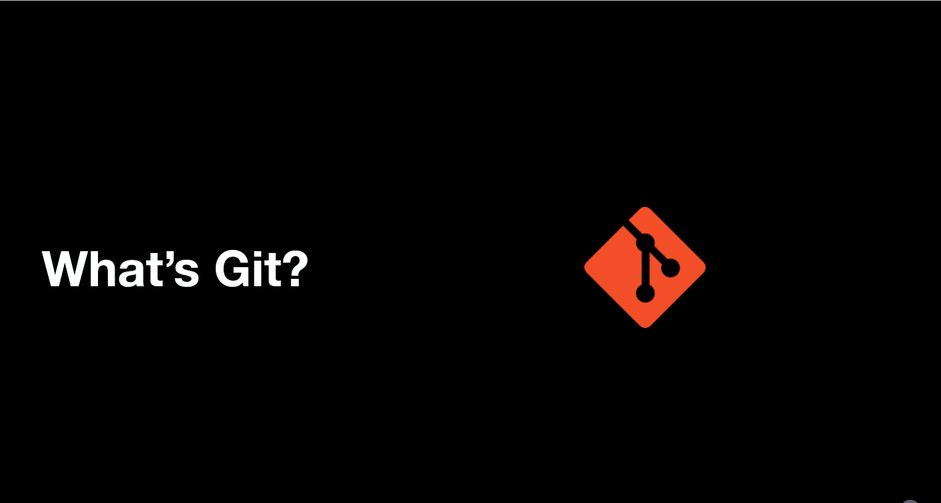

Slide 2
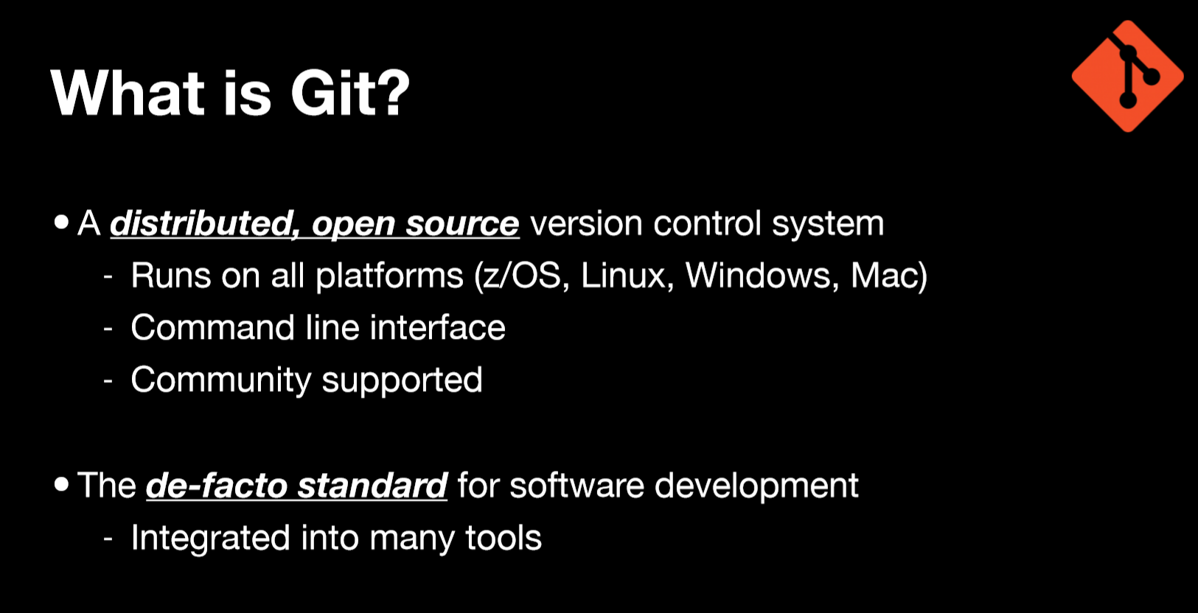


Slide 3
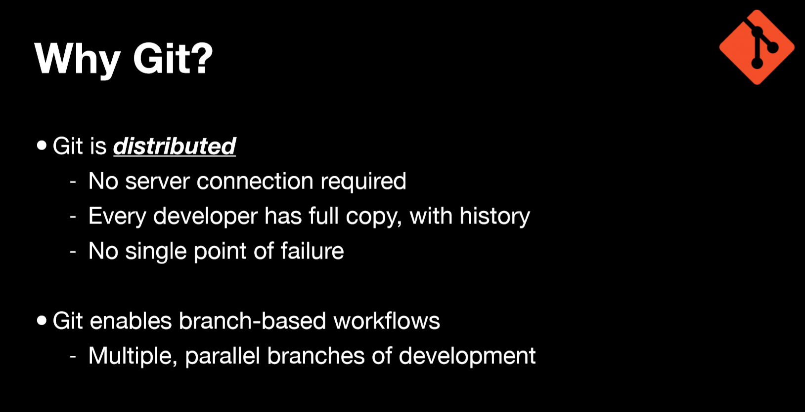

Slide 4
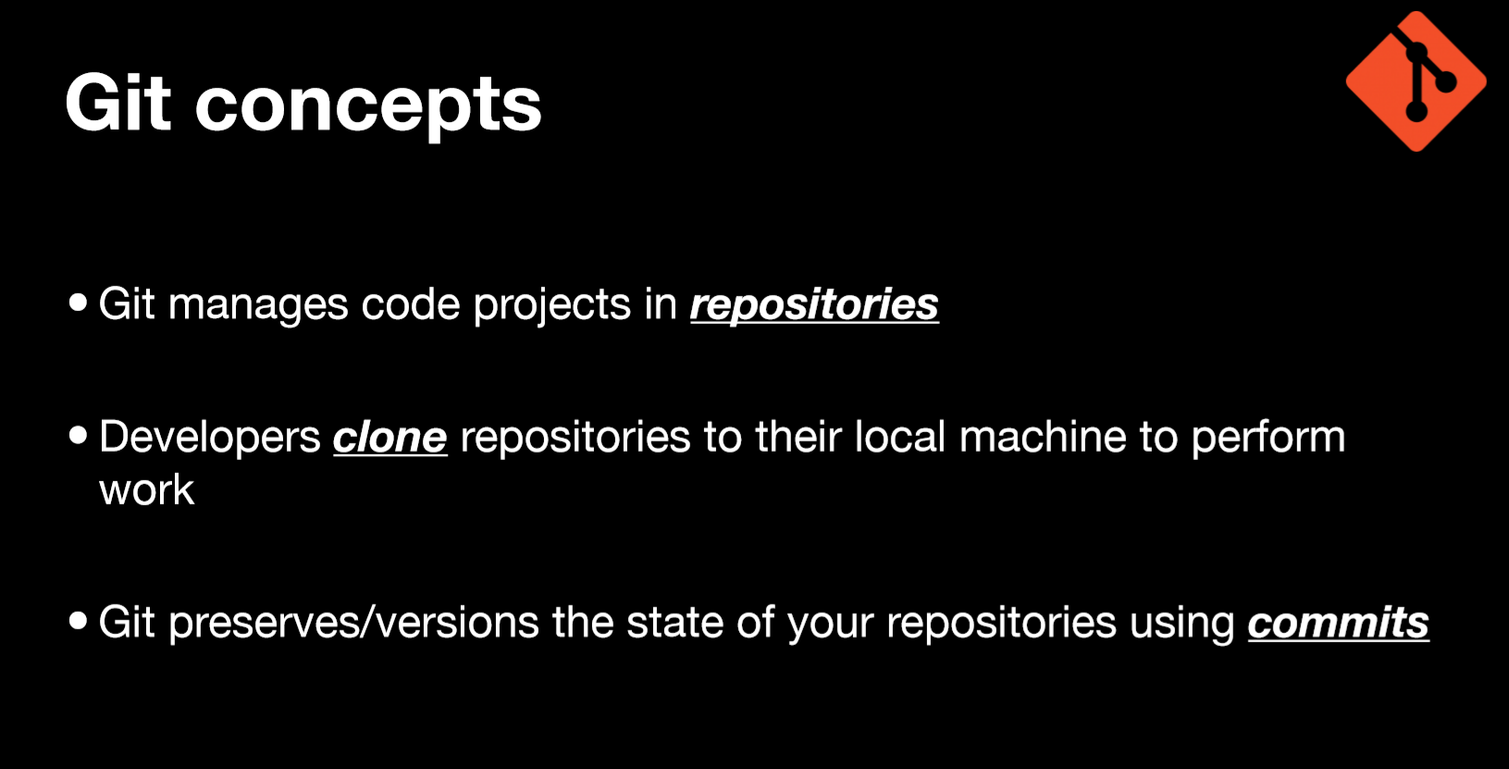

Slide 5
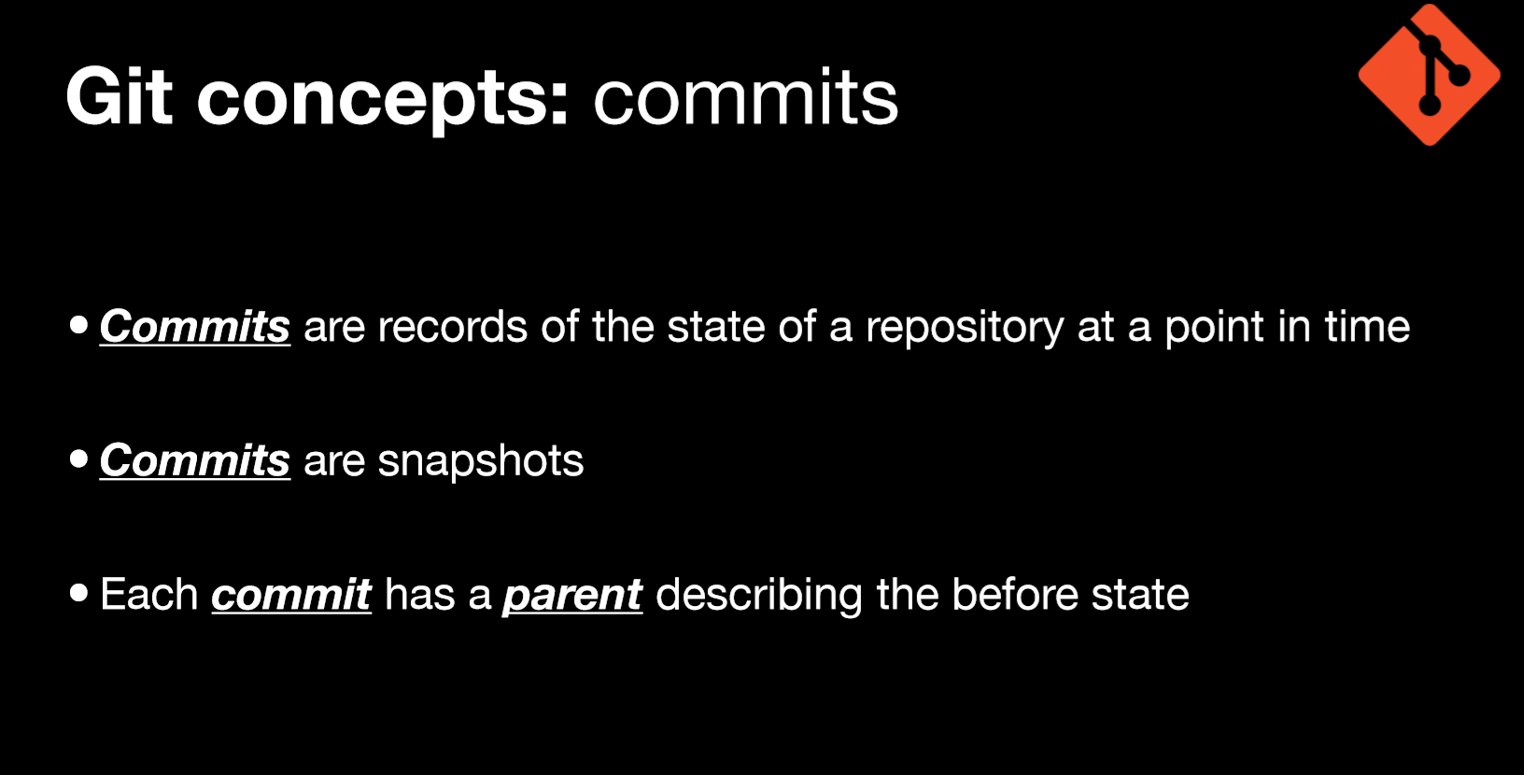
Commits are records of the state of a repository at a point in time
Commits are snapshots
Each Commit has a parent describing the before-state
Fallback to prior a prior Commit points is built-in

Slide 6
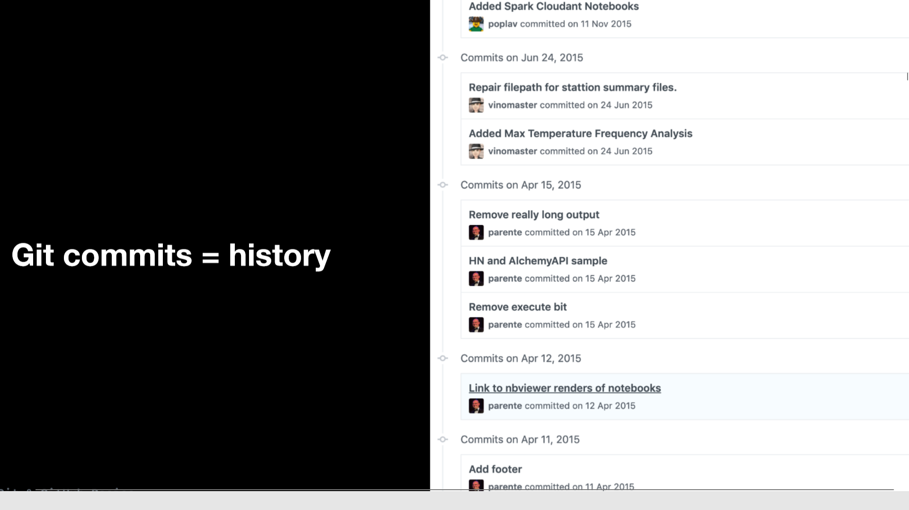
Git commits = History
An auditable record of approved changes

Slide 7
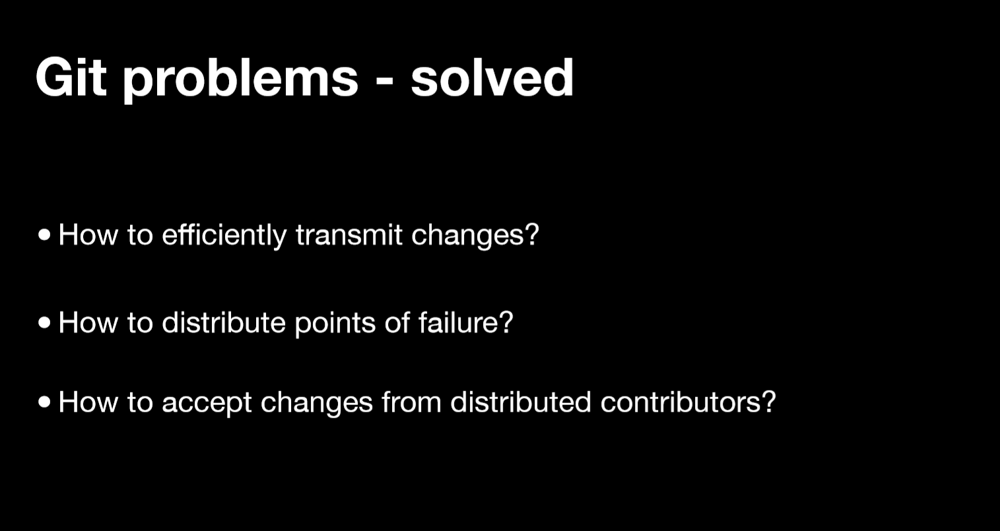

Slide 8
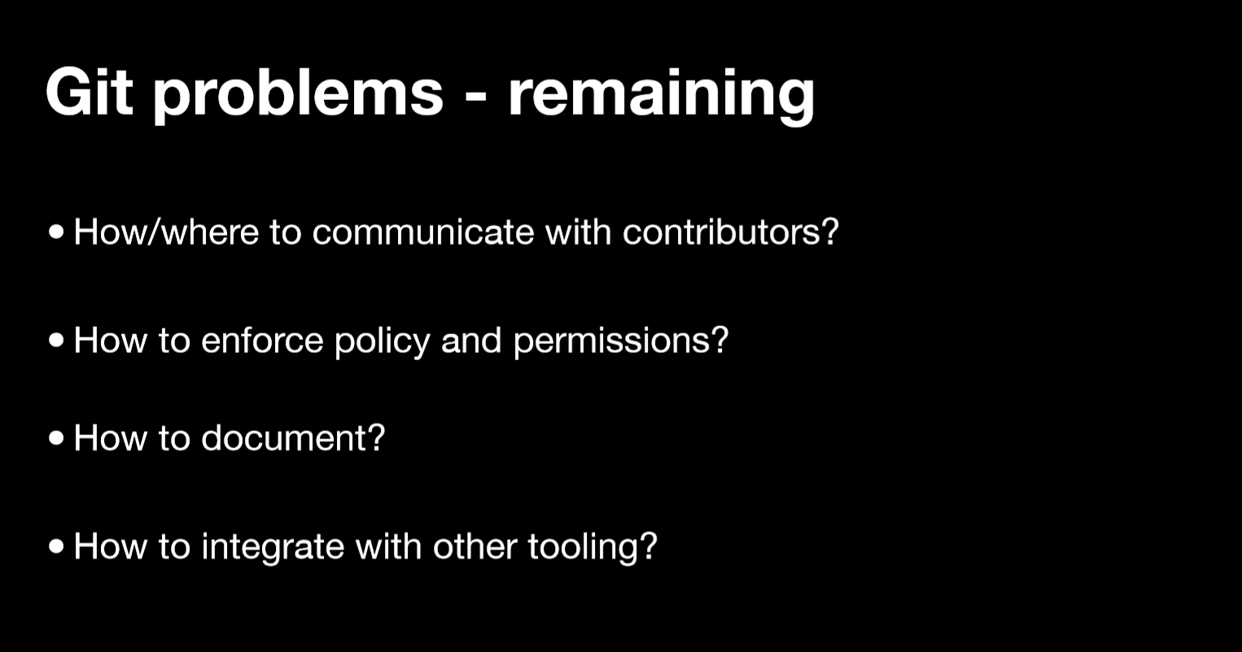

Slide 9
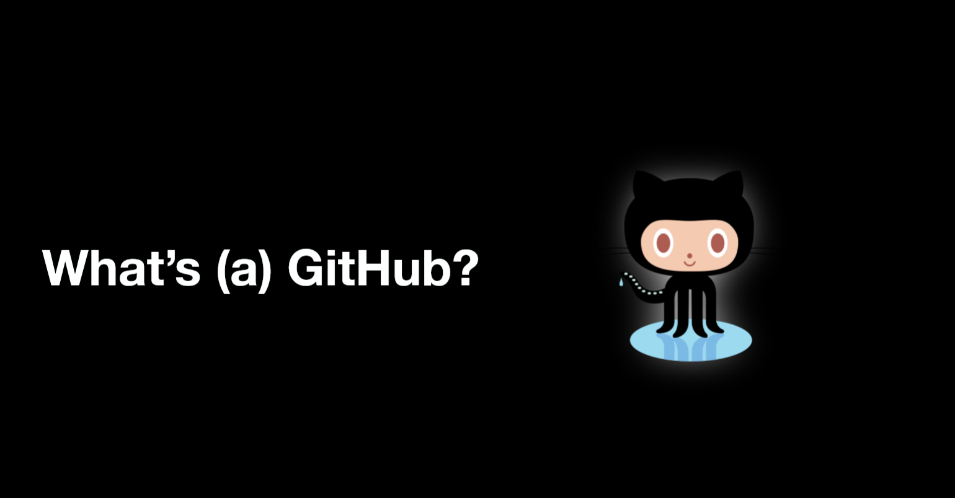

Slide 10
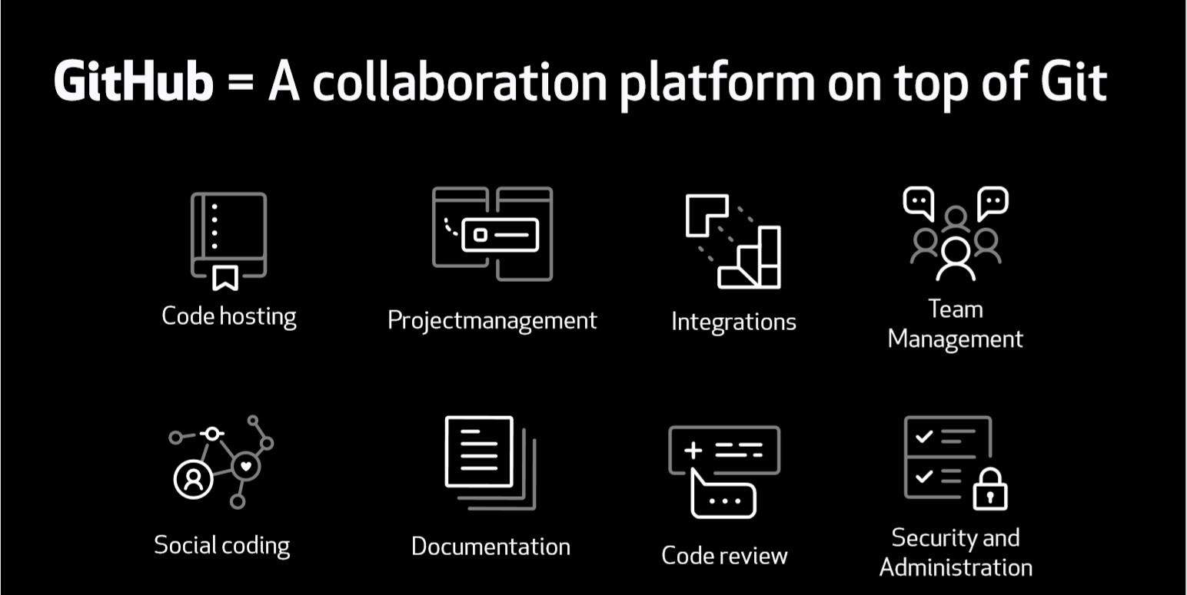

Slide 11
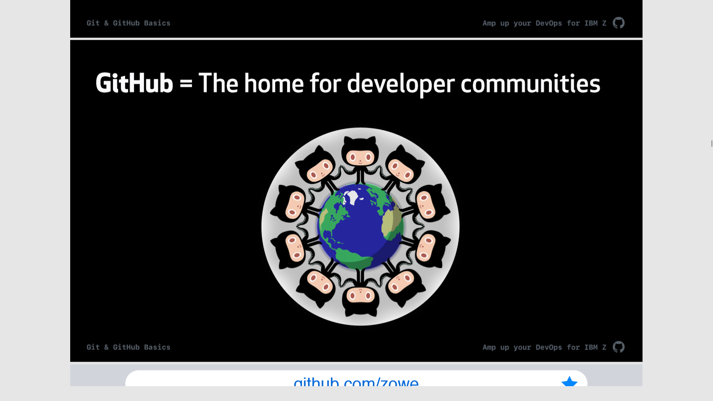
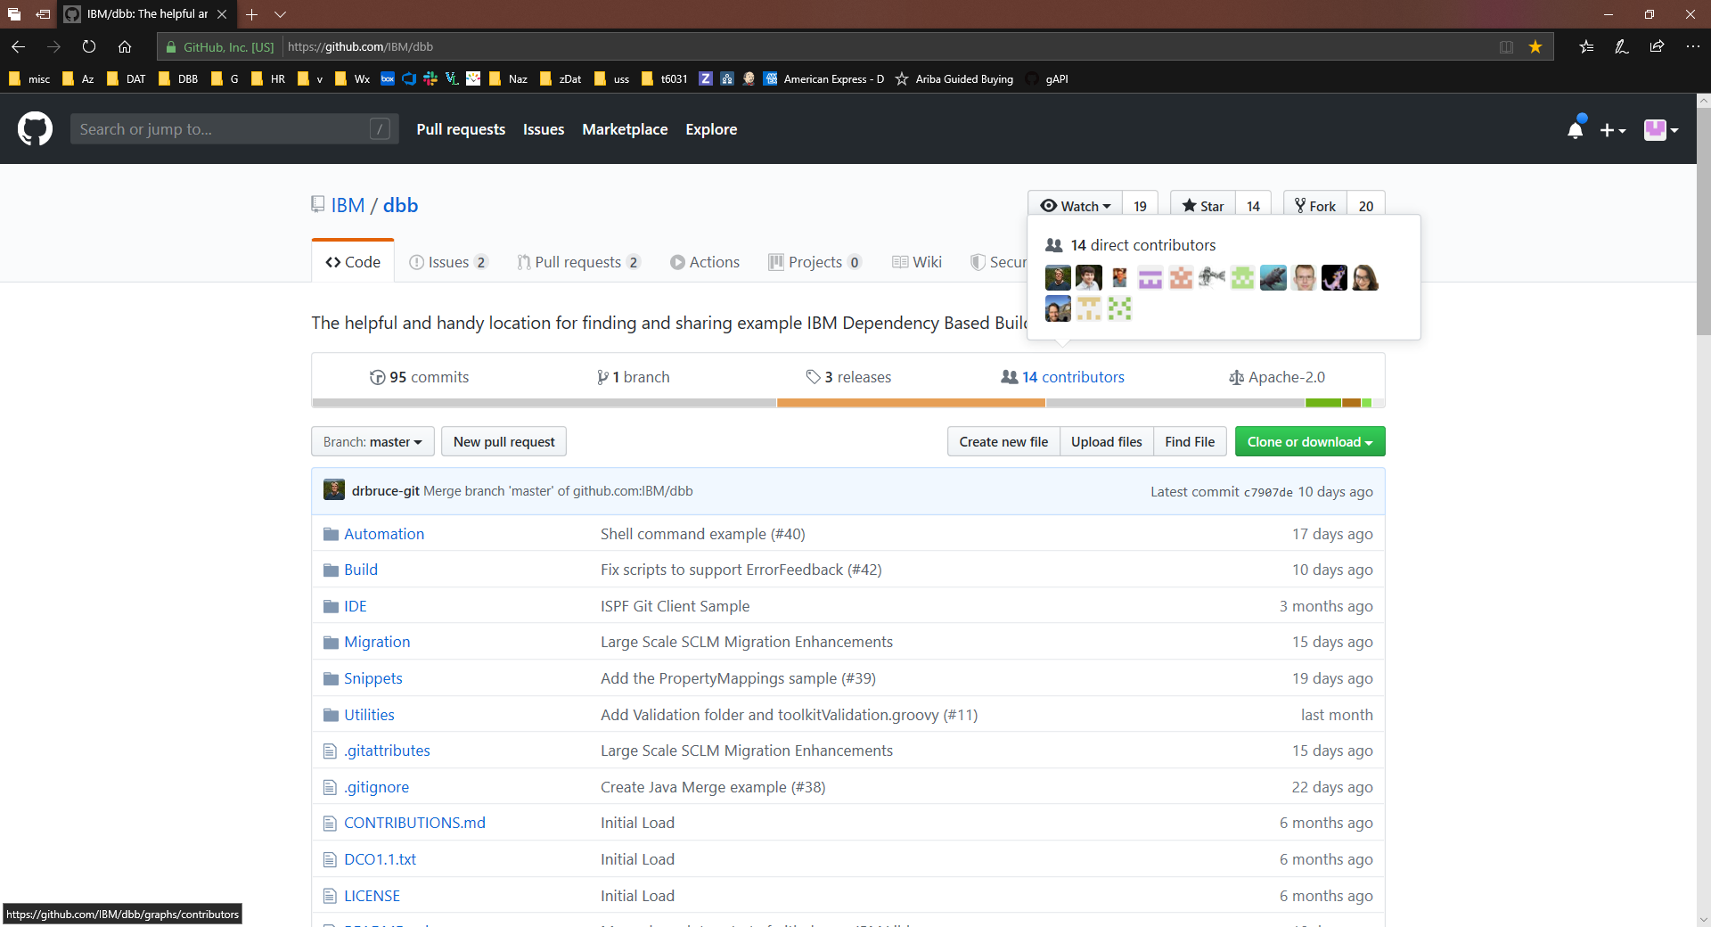
GitHub = The home for developer communities near and far

Slide 12
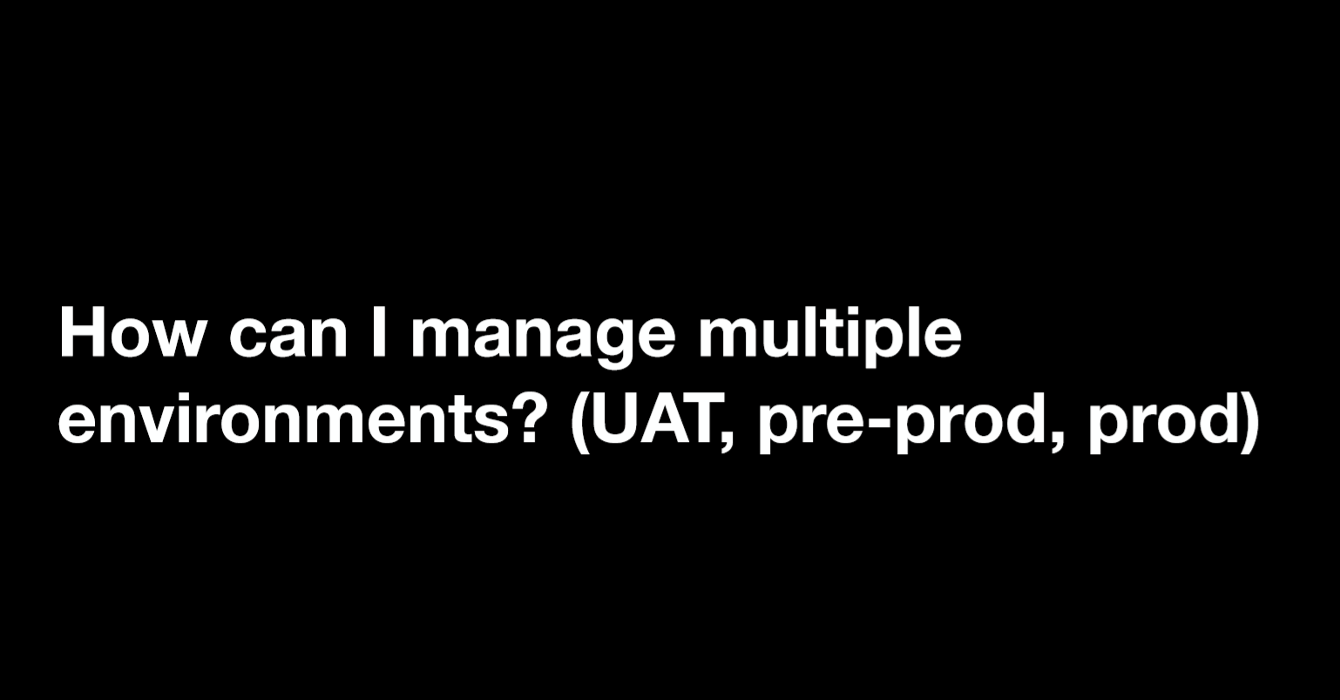
Show the chg in github for branch

Slide 13
One way is through branching

Slide 14
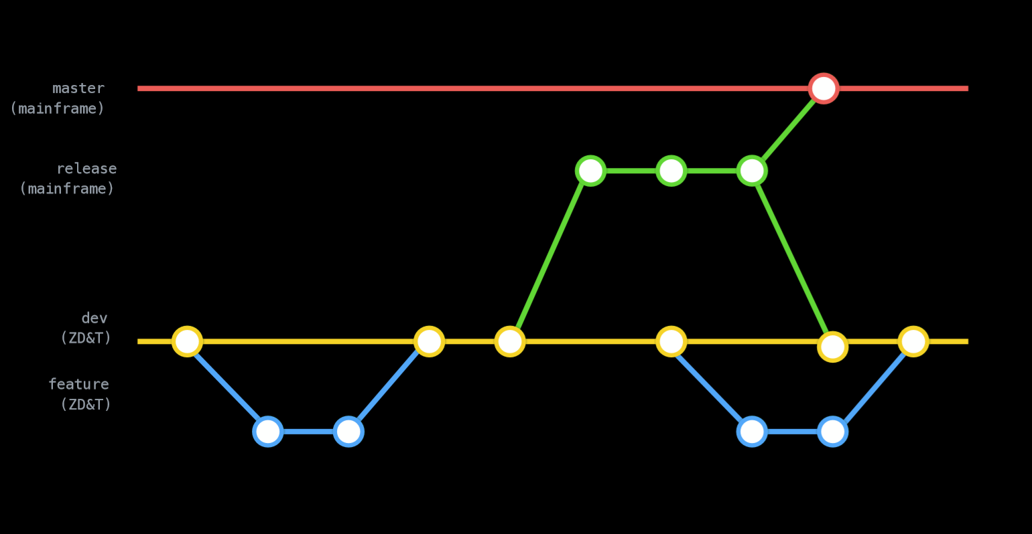

Slide 15
Your Cobol code on Git/DBB

Slide 16
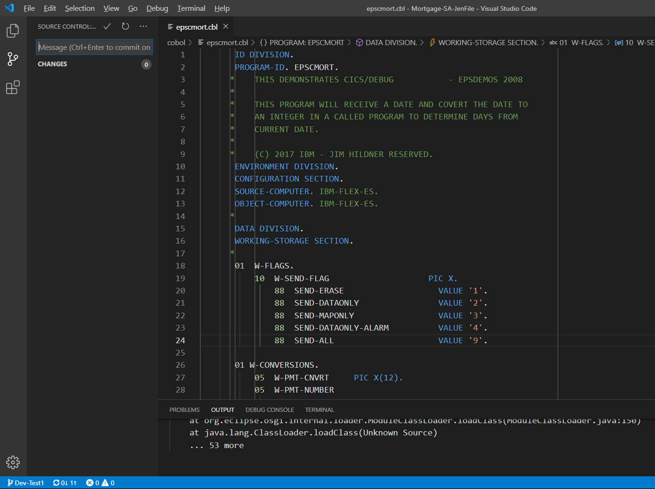
Modern IDE with Git plugin.
Create a branch
Make a change
Commit

Slide 17
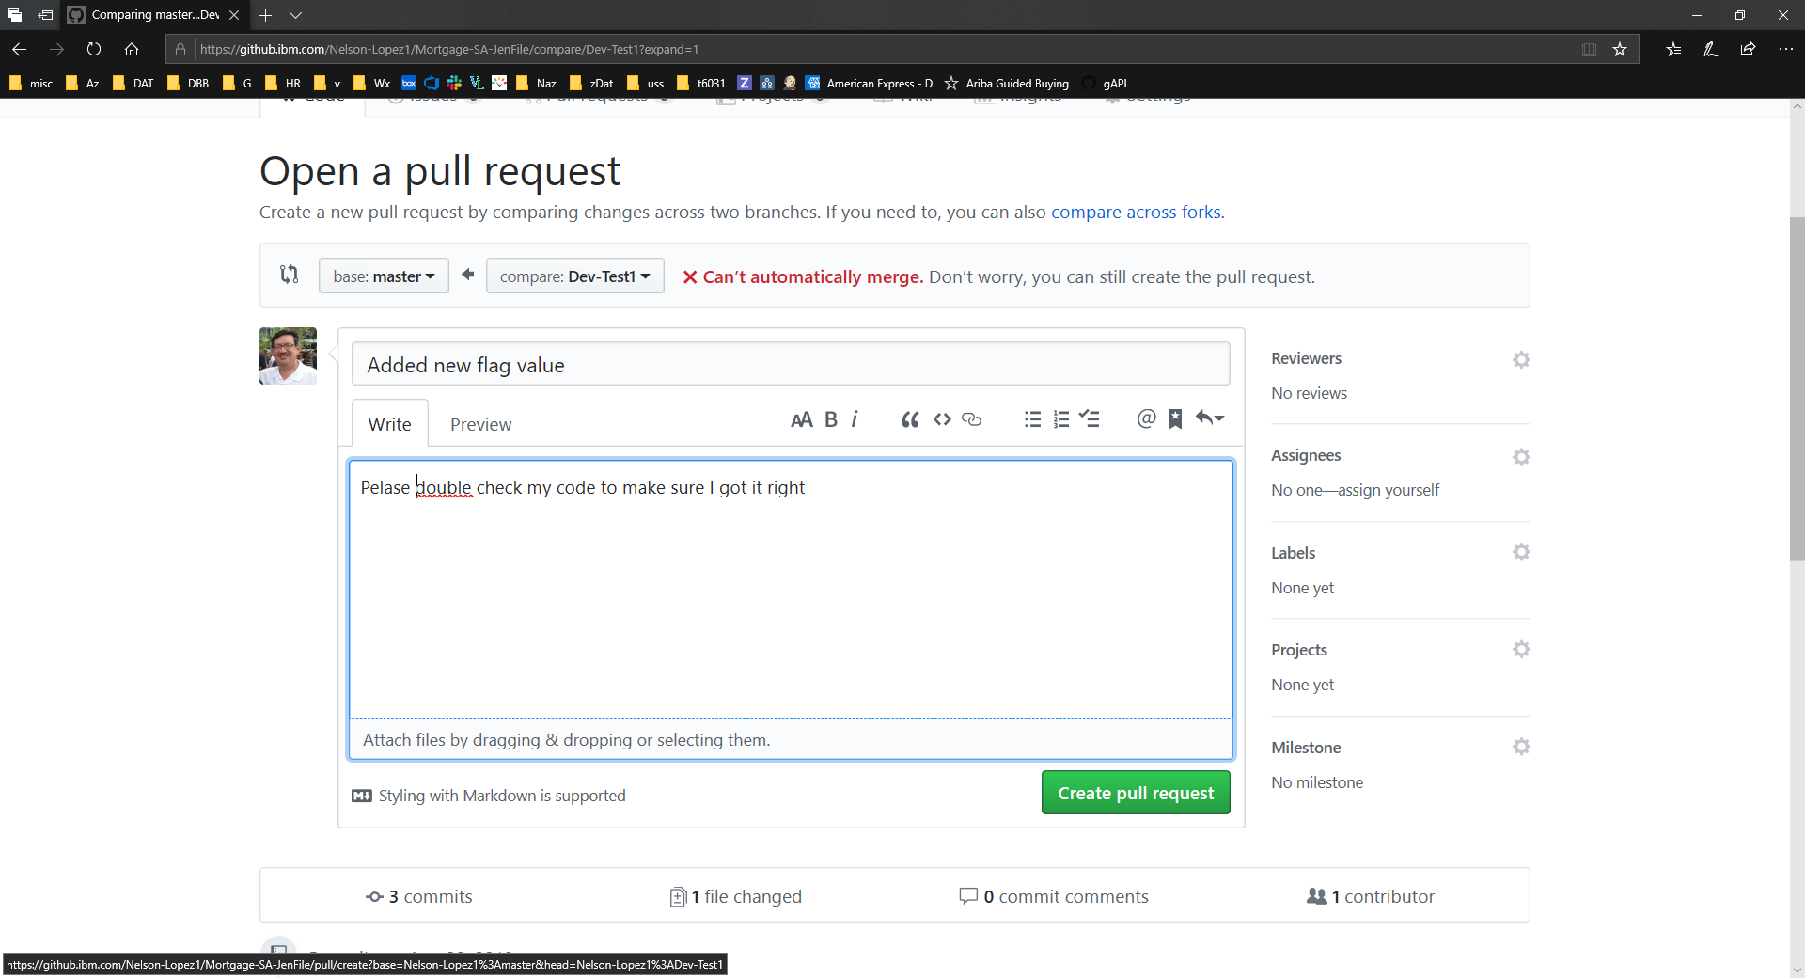
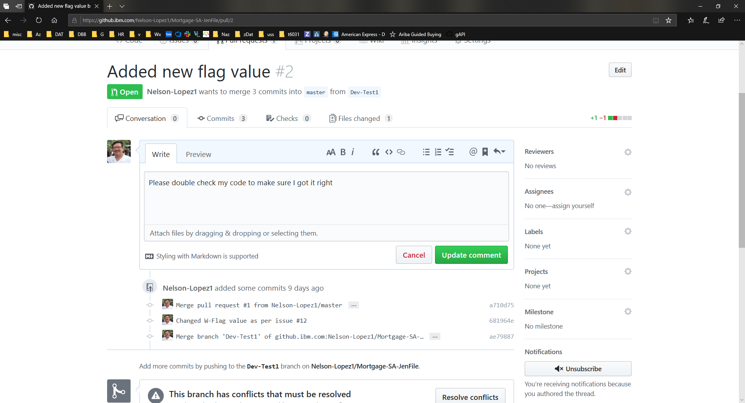
Document the change
&
Create a Pull Request (PR)

Slide 18
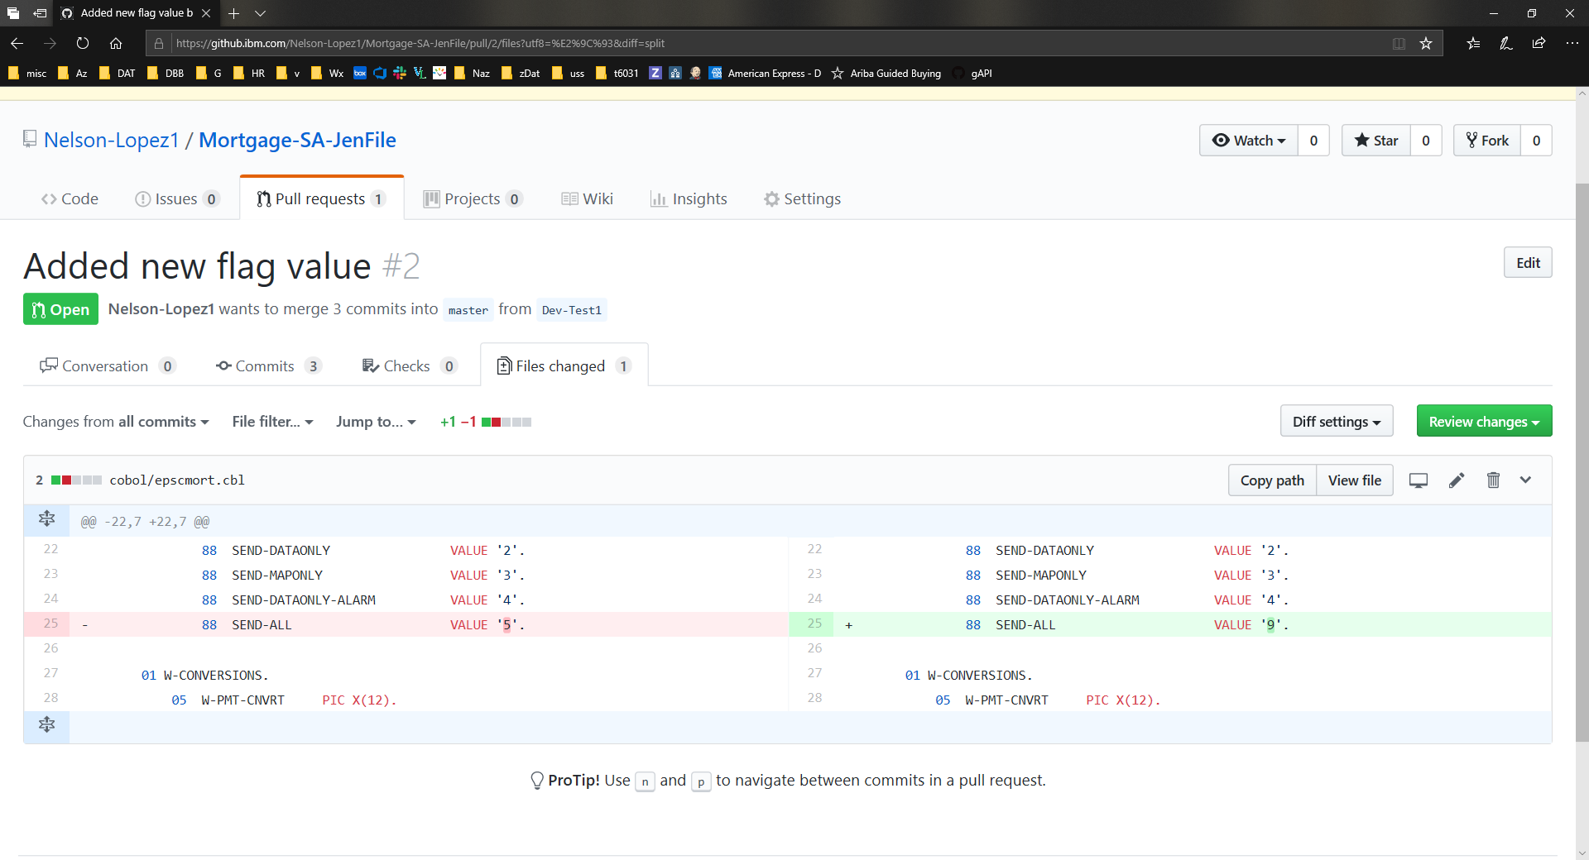
Peer Code Review
Diff old vs new

Slide 19
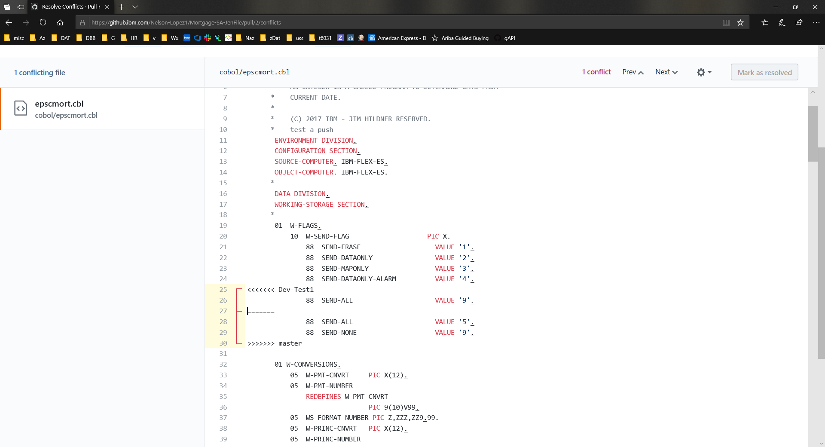
Opps … catching merge conflicts

Slide 20
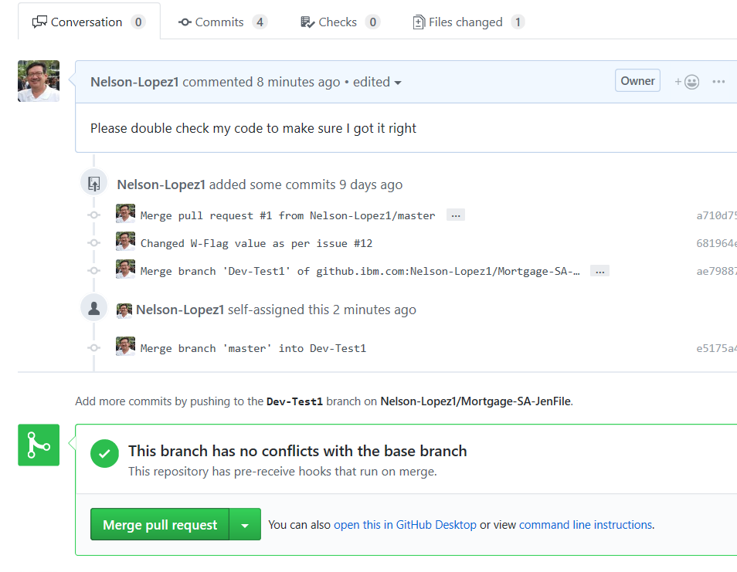
Merge the PR
to
trigger a pipeline

Slide 21
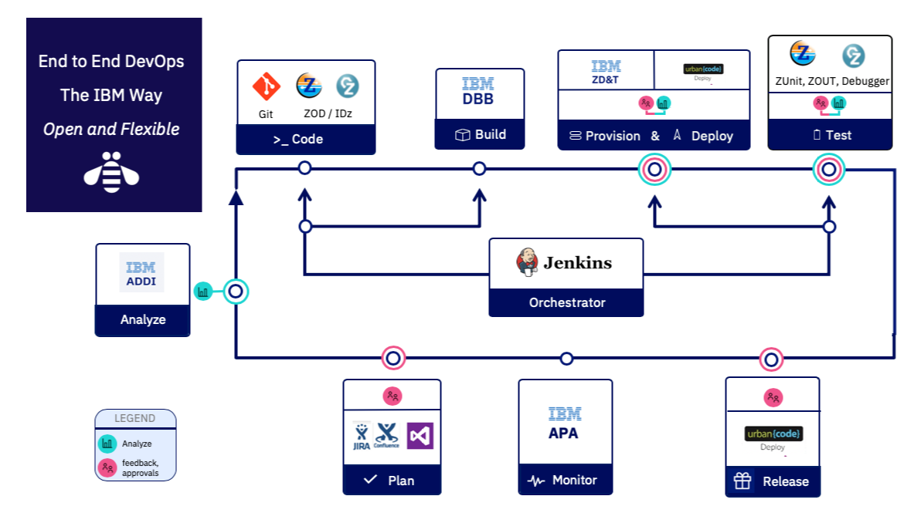

Slide 22
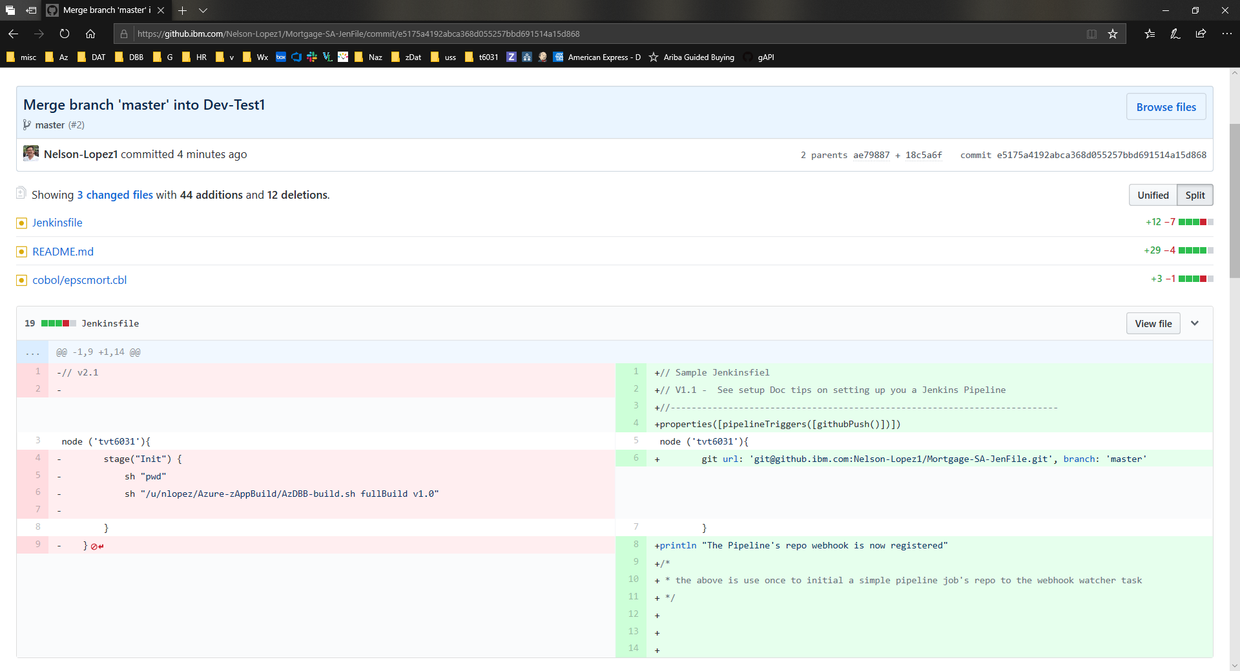
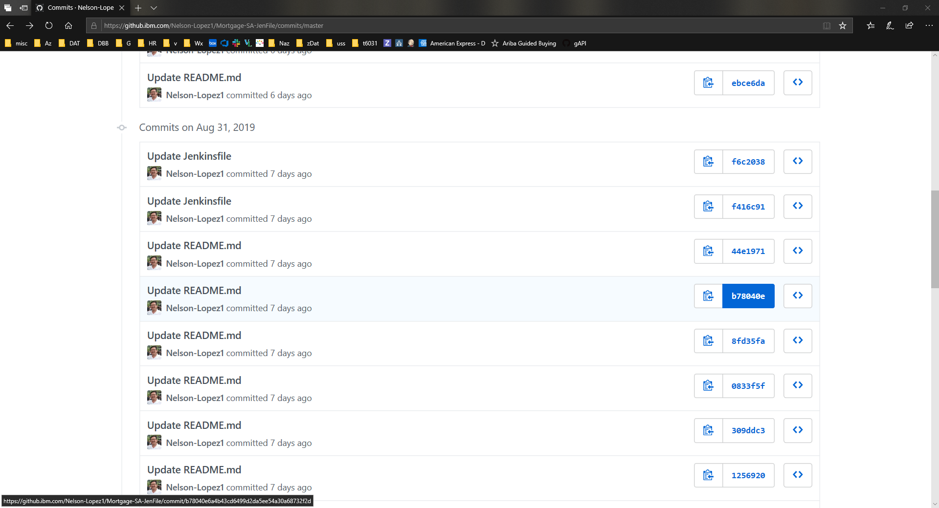
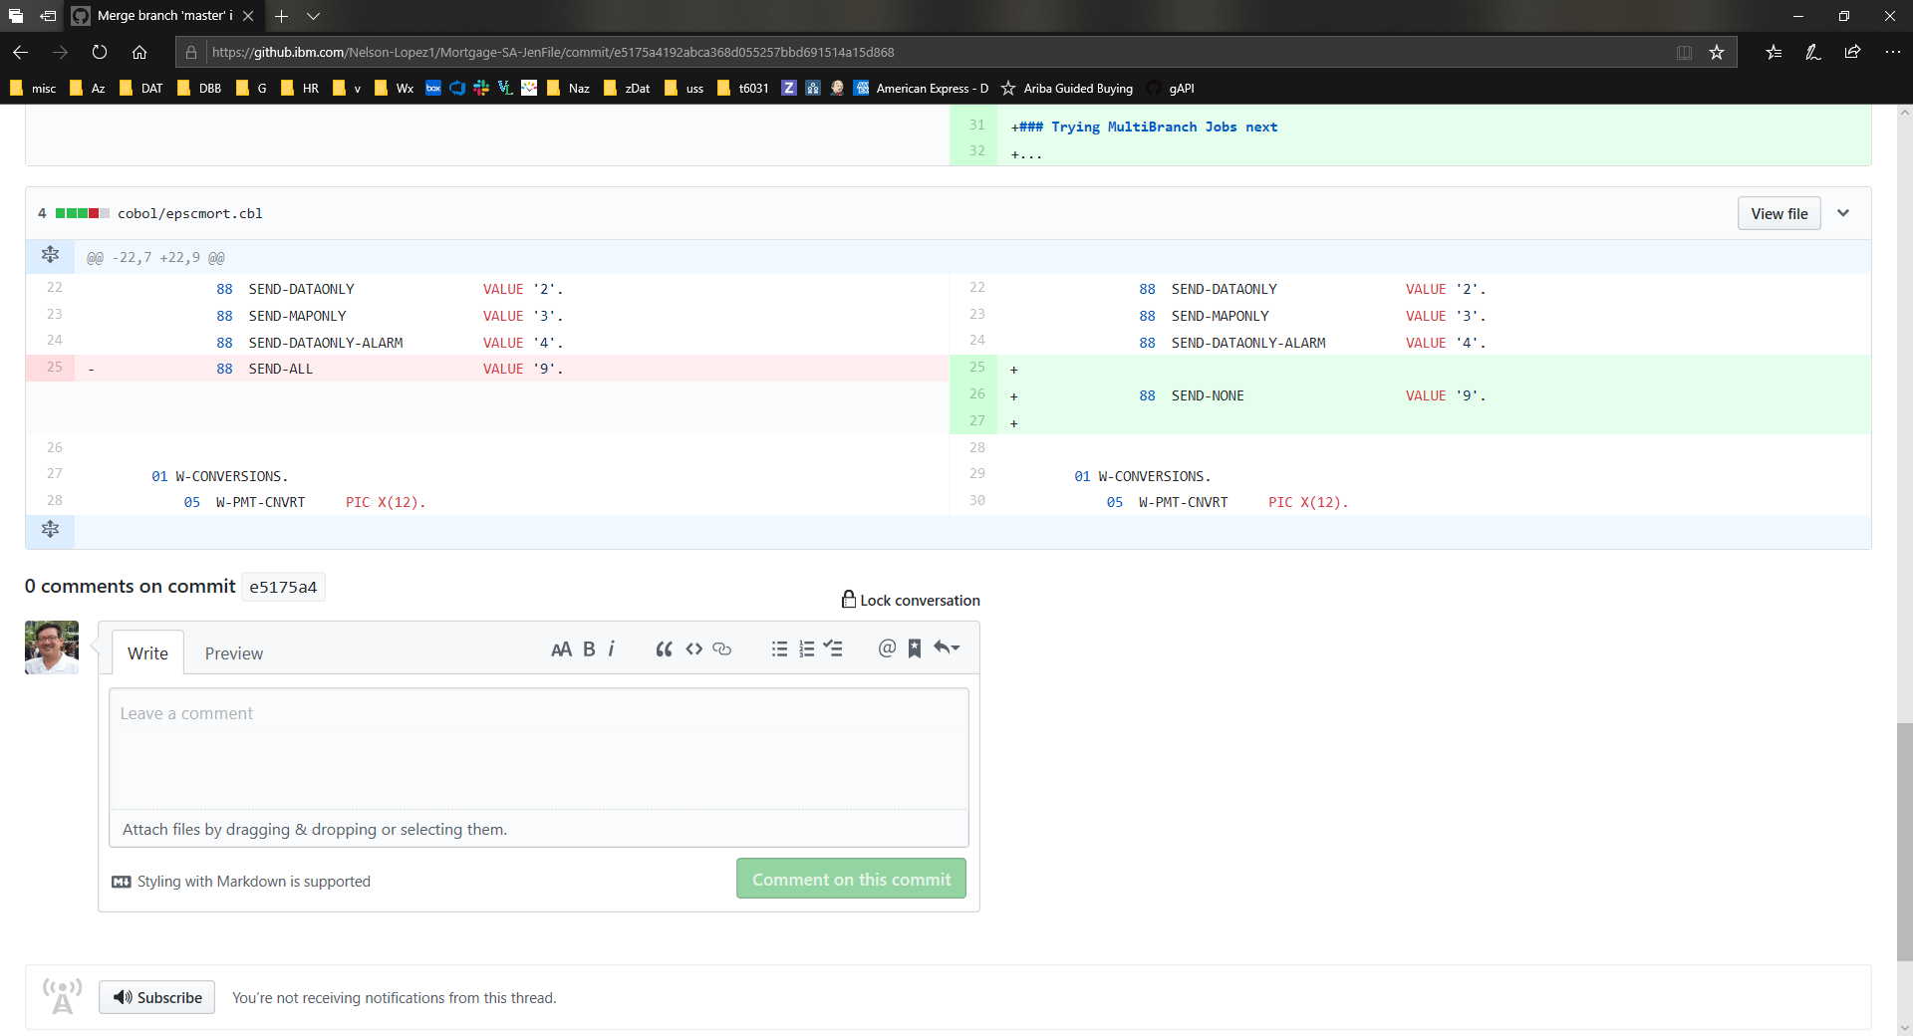
View Commit History

Slide 23
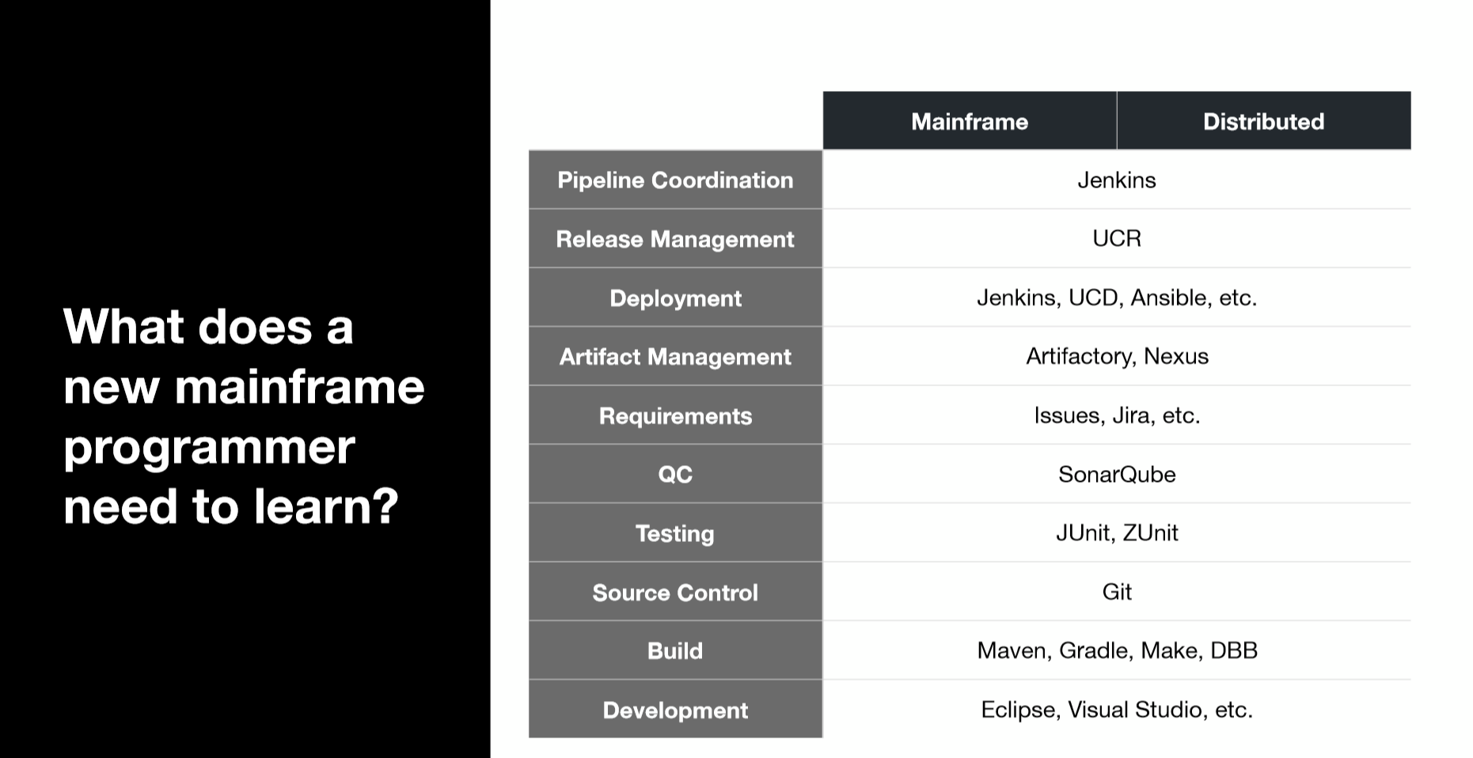
A common toolchain for all

Slide 24
Migrating to DBB-Git
Tools, Automation and Services

Slide 25
Installation, configuration of tools
Jenkins, Git client, IBM Dependency based Build
SCM migration PDS’s to GIT
Scripting your pipeline
Training
What’s involved with moving to Git?

Slide 26





IBM DevOps Acceleration Program - Migration planning, tools and services
Analysis Tools
Questionnaire
Extraction Tools
BP/Client Tools
Scanner Tools
Application Discovery (ADDI)
Migration Tools
CI/CD
CI/CD Pipeline
SCLM
JCL
Source Code
Analyse
Extract
Componentize
CI/CD
Migrate
Analysis
Analyse the development process, infrastructure and document the current state
Extract Metadata, Source Libraries, Compile Procedures and options, Languages, File types from Host SCM
Identify Interfaces and dependencies between applications and boundaries
Derive future state architecture
Establish CI/CD workflow
Product deployment
Setup repos and Import
Setup the scripts and establish the pipeline

Slide 27
Thank You

